Slide 1
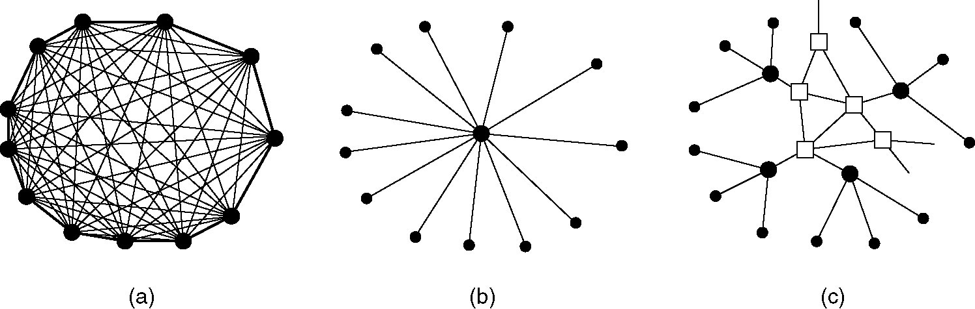
Structure of the Telephone System
(a) Fully-interconnected network
(b) Centralized switch
(c) Two-level hierarchy

Slide 2
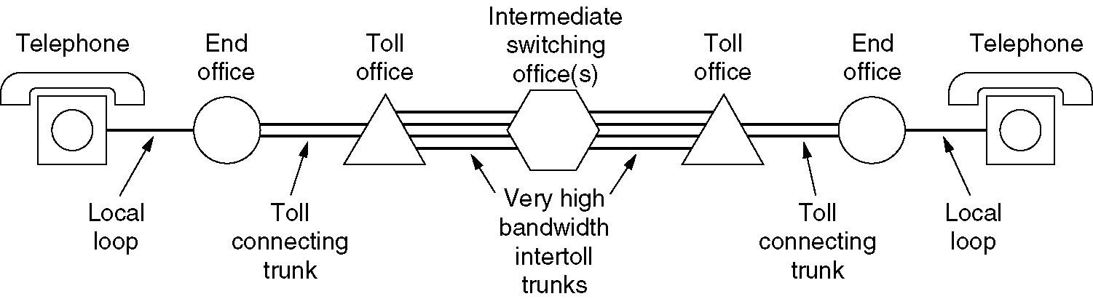
Structure of the Telephone System
A typical circuit route for a medium-distance call

Slide 3
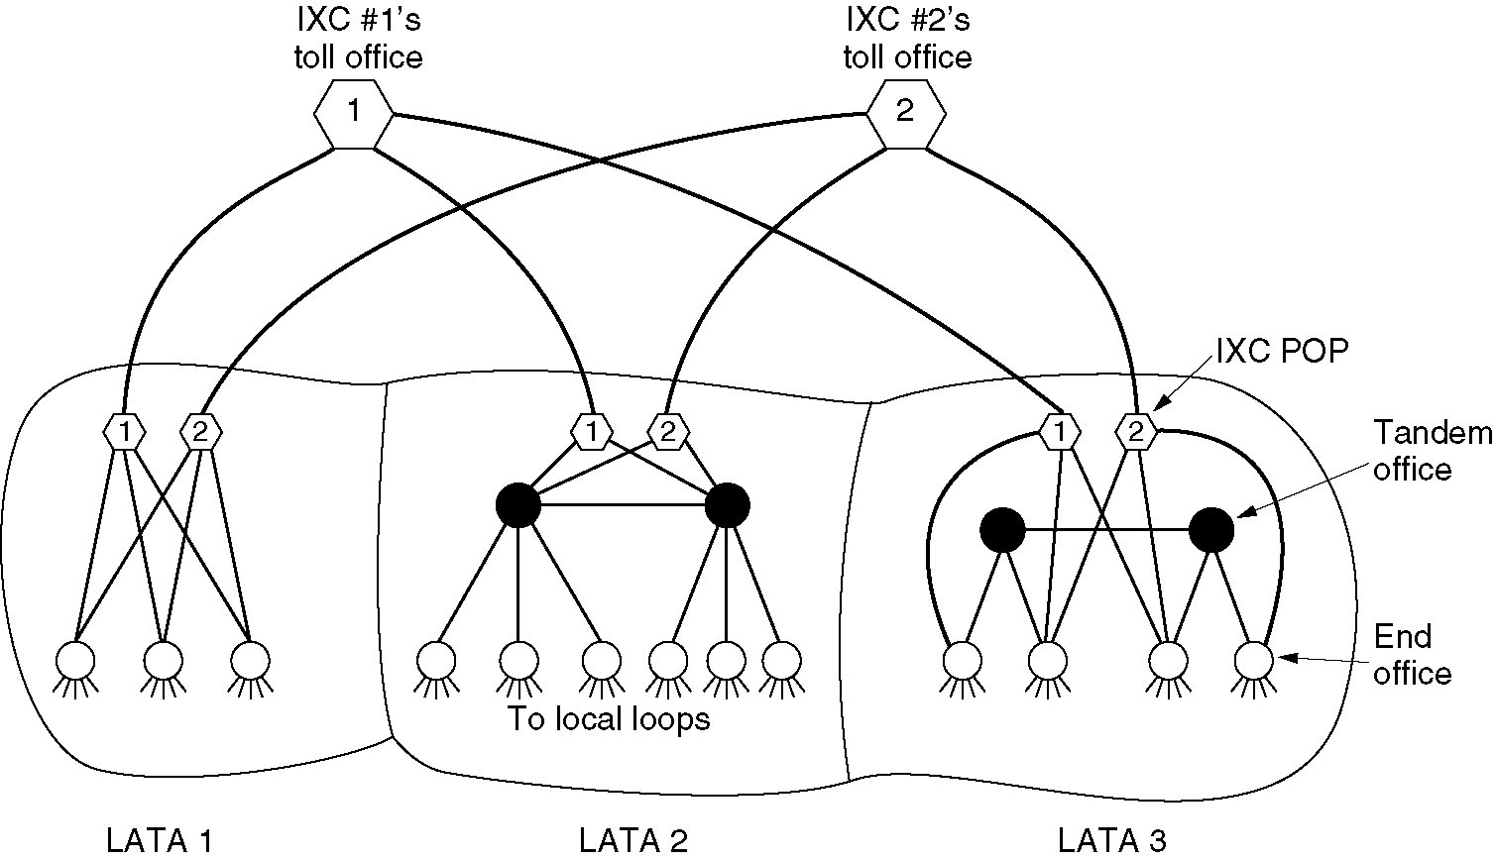
Telephone Infrastructure in US
Relationships of LATAs, LECs, and IXCs
  Circles are LEC switching offices
  Each hexagon belongs to IXC whose number is on it

Slide 4
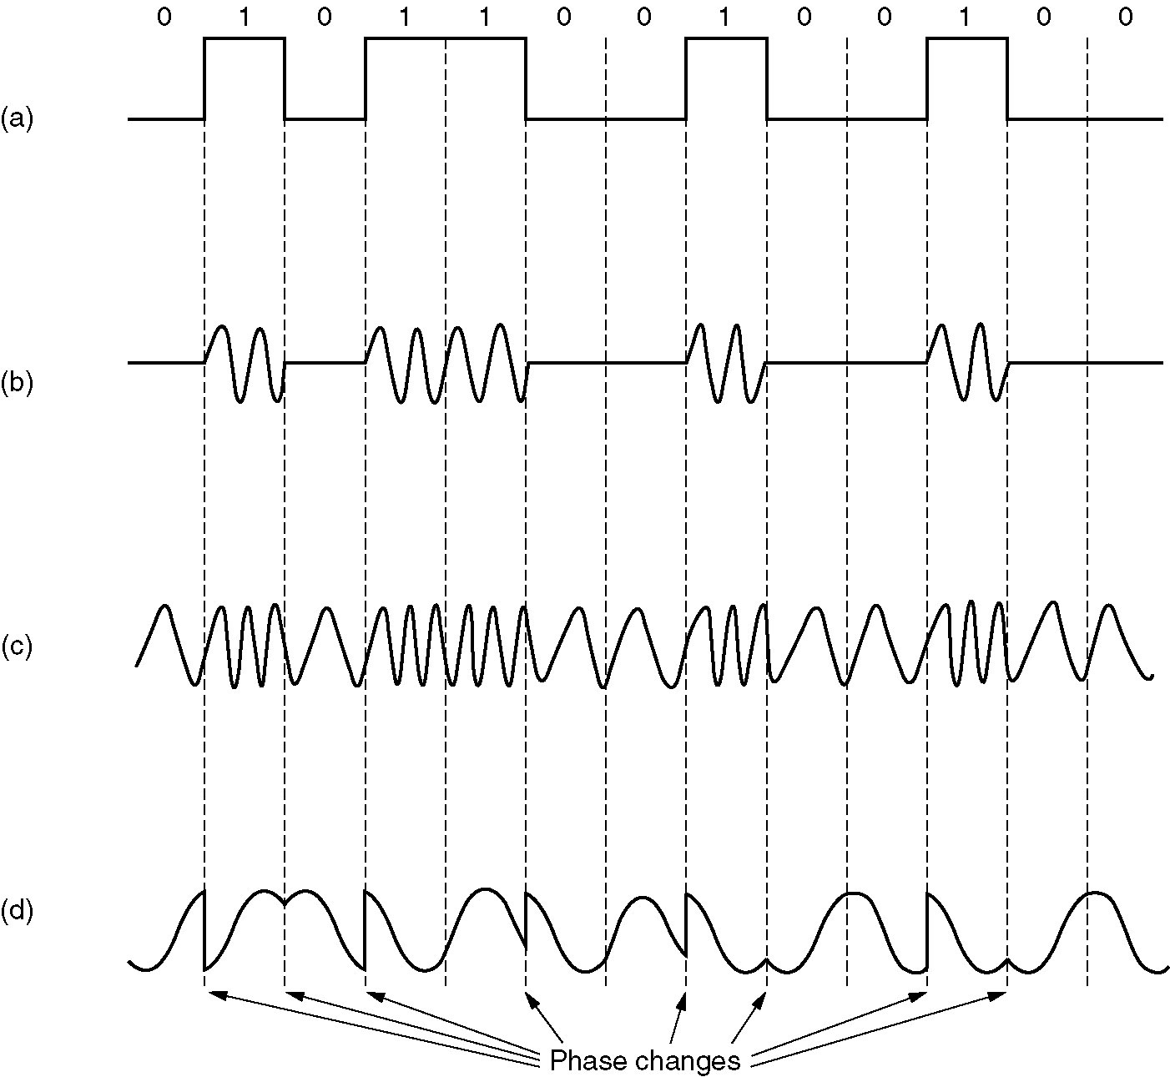
Keying or Modulation Example
(a) A binary signal
(b) Amplitude modulation
(c) Frequency modulation
(d) Phase modulation

Slide 5
Modems
Sampling rate is increased to get higher speeds
Baud
  Number of samples or signal events/sec
  One symbol sent during each baud
    Eg) If voltage values are 0-3, every symbol has 2 bits
  Unit of signaling speed
  ≠ data or bit rate

Slide 6
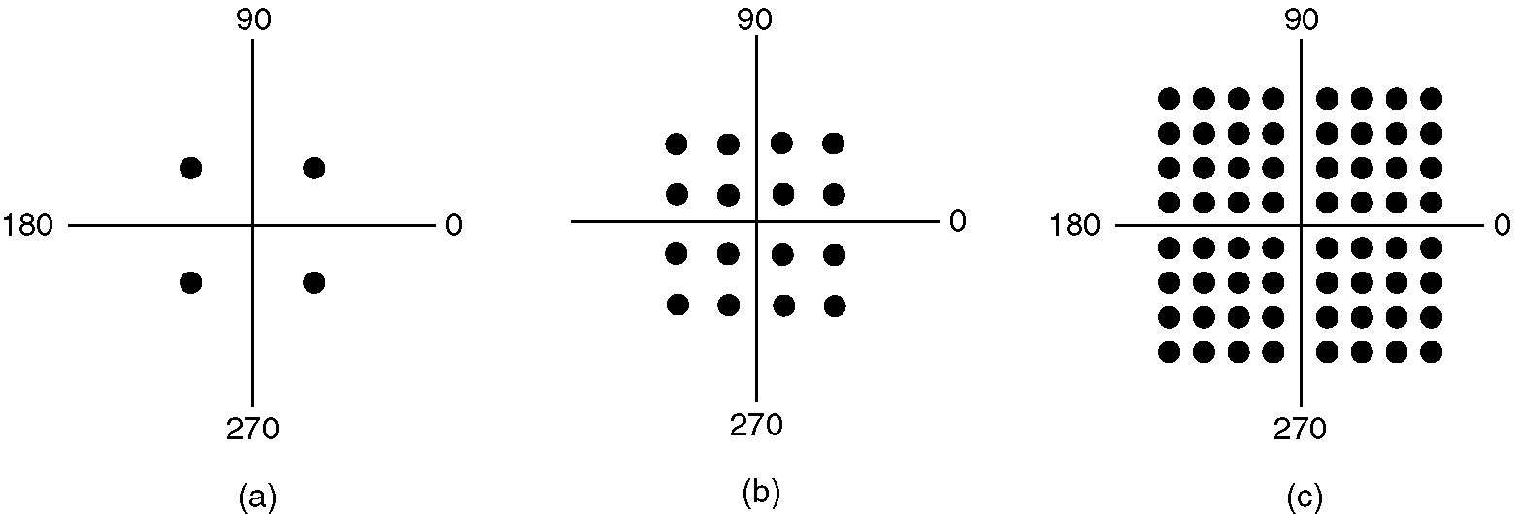
QAM Example – Constellation Diagrams
(a) QPSK
(b) QAM-16
(c) QAM-64

Slide 7
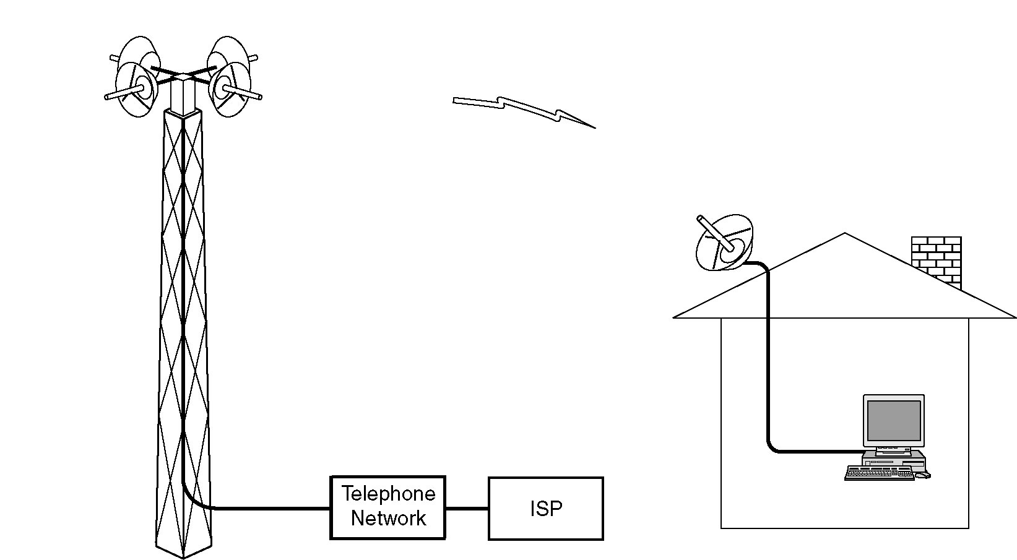
Wireless Local Loops
Architecture of an LMDS system.

Slide 8
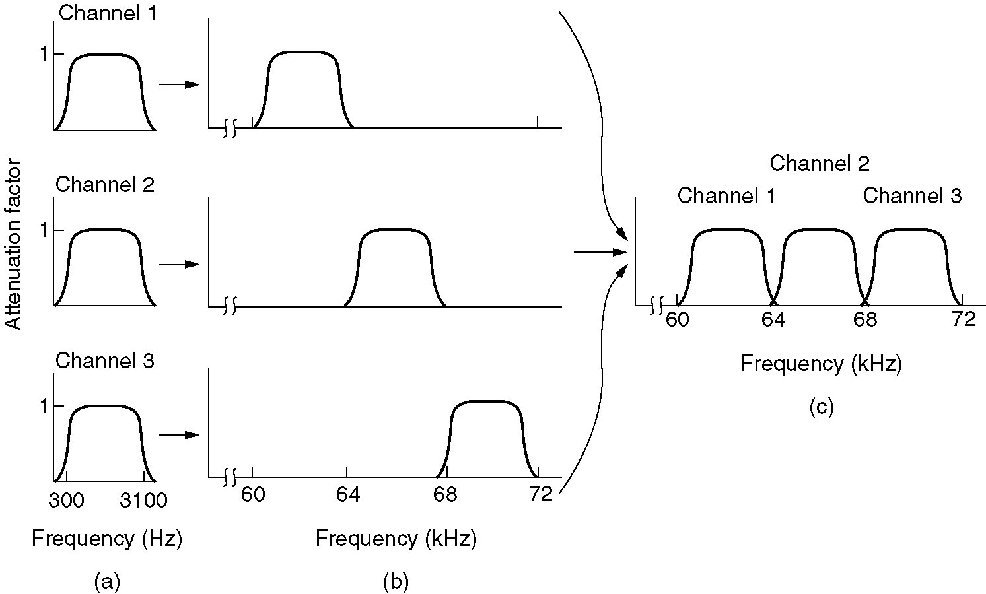
Frequency Division Multiplexing
(a) The original bandwidths
(b) The bandwidths raised in frequency
(b) The multiplexed channel
Note that the usable bandwidth is about 3100 Hz per voice-grade channel, and 4000 Hz is allocated to each channel to keep them separated.

